Slide 1

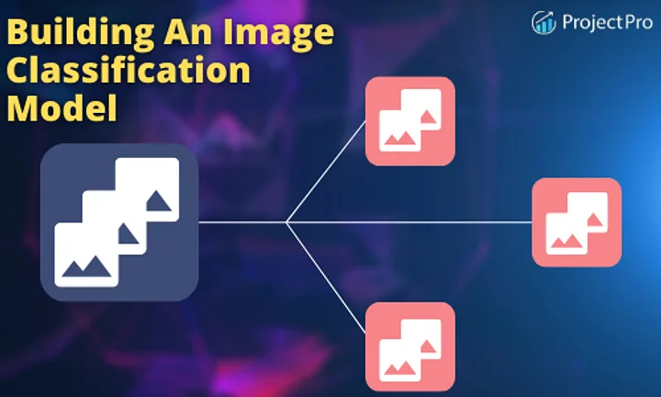
Image Classification model
Submitted by : Bhushan Kumar Sharma
Designation: Intern Data Scientist
Company : Flip Robo Technologies

Slide 2
Problem Statement
Images are one of the major sources of data in the field of data science and AI. This field is making appropriate use of information that can be gathered through images by examining its features and details. We are trying to give you an exposure of how an end to end project is developed in this field.
The idea behind this project is to build a deep learning-based Image Classification model on images that will be scraped from e-commerce portal. This is done to make the model more and more robust.
This task is divided into two phases: Data Collection and Mode Building.

Slide 3
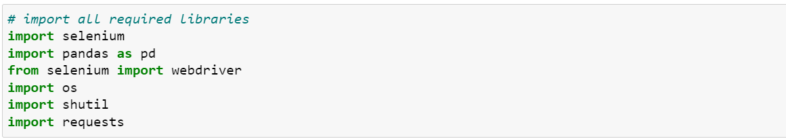
Data Collection Phase
Used Libraries
Selenium is used to extract the image
OS is used to deal with file
Requests to make connection with web page

Slide 4
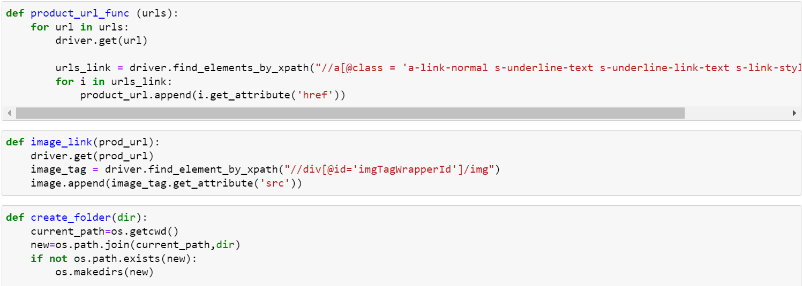
Data Collection Phase
Created Functions to extract images from amazon

Slide 5
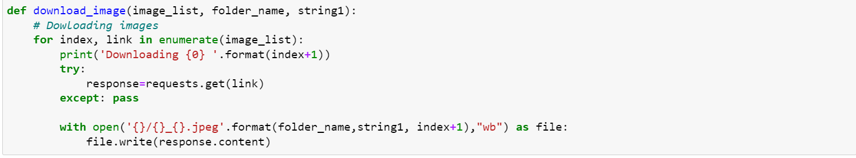
Data Collection Phase
Created Functions to extract images from amazon
Product_url function: This function is created to extract the all url of the current page
Image_link function: This function is created to extract the all image link
Created_folder: used to create the folder
Download_img : it is used to download the images by taking urls of images

Slide 6
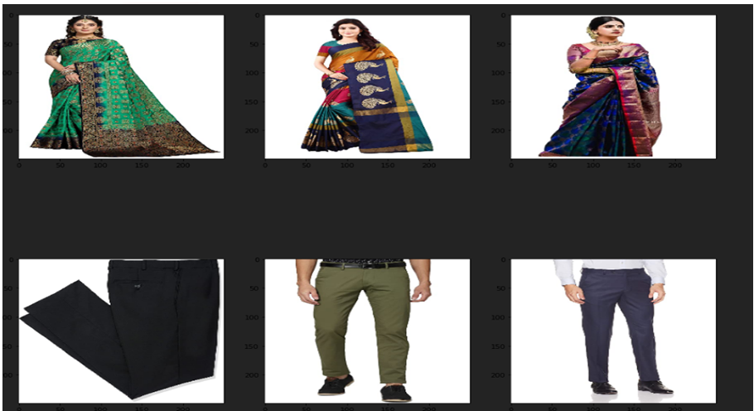
Data Collection Phase
Extracted Data
Few sample images from the scraped images

Slide 7
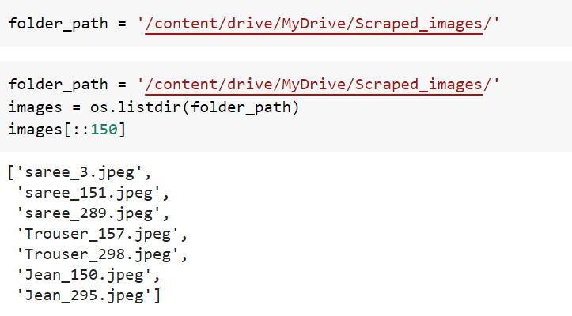
Model Building Phase
Extracted Data
Extracting images from the drive

Slide 8
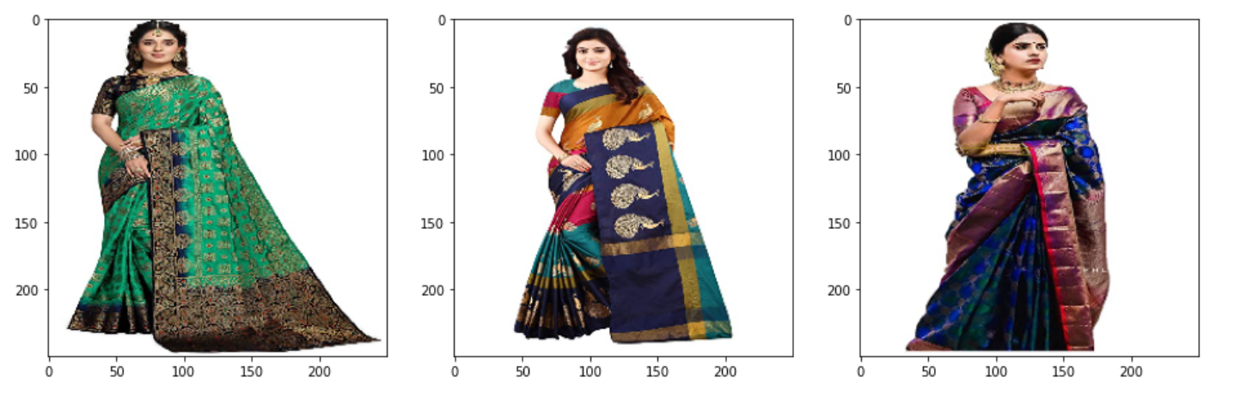
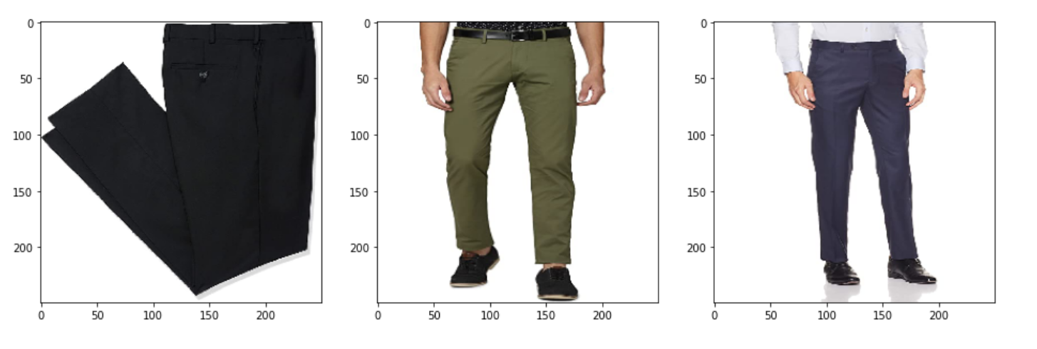
Model Building Phase
Sample Images
Few Sample images

Slide 9
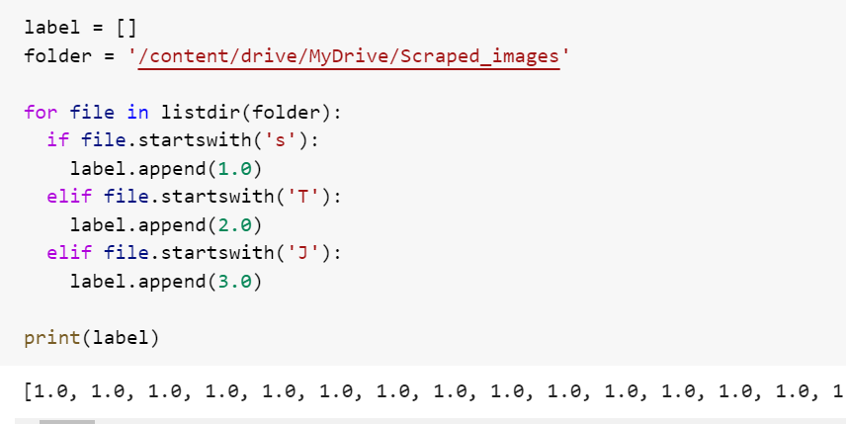
Model Building Phase
Target Column
Here, we have created label column for classifying the images

Slide 10
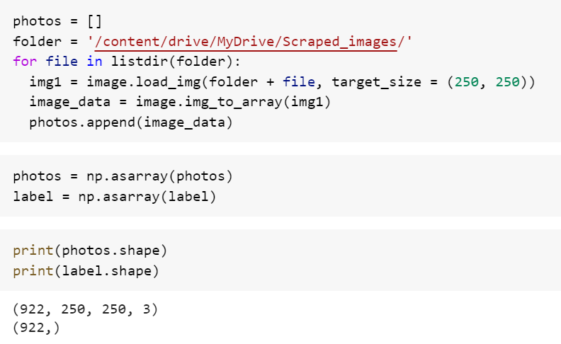
Model Building Phase
Variables
Extracting images from drive and reshaping it.

Slide 11
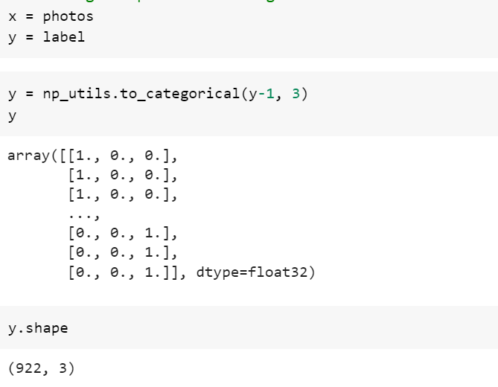
Model Building Phase
Dependent and Independent Columns
Label columns is converted into categorical form as shown in the image

Slide 12
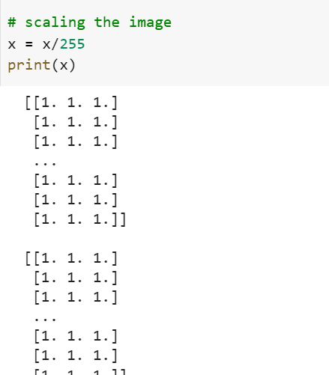
Model Building Phase
Scaling
Scaling the feature column

Slide 13
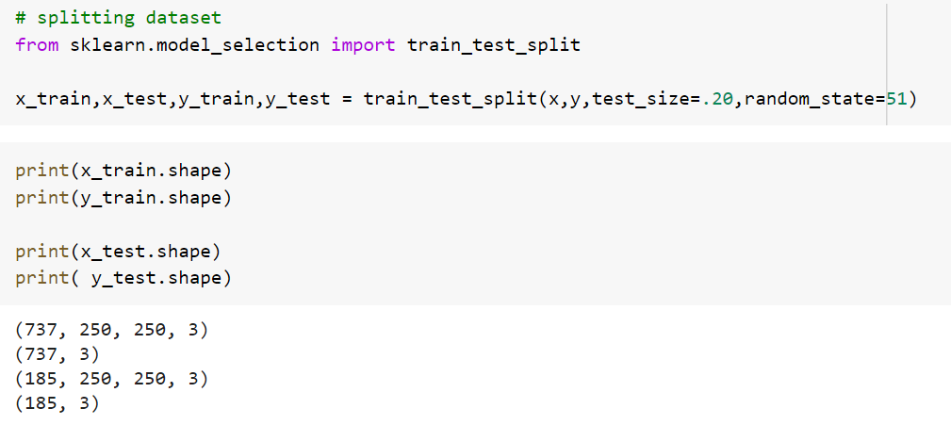
Model Building Phase
Splitting Dataset
Spliting the dataset into train and test dataset

Slide 14
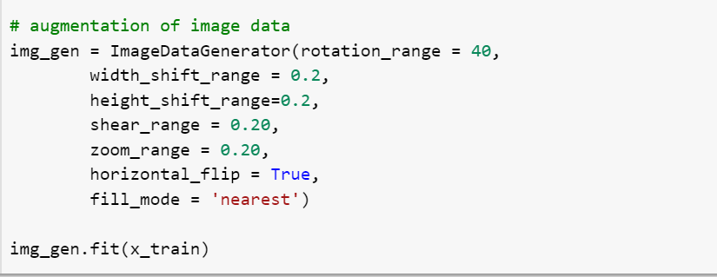
Model Building Phase
Augmentation of the image data
Taking different view by generating different image view from one single image

Slide 15
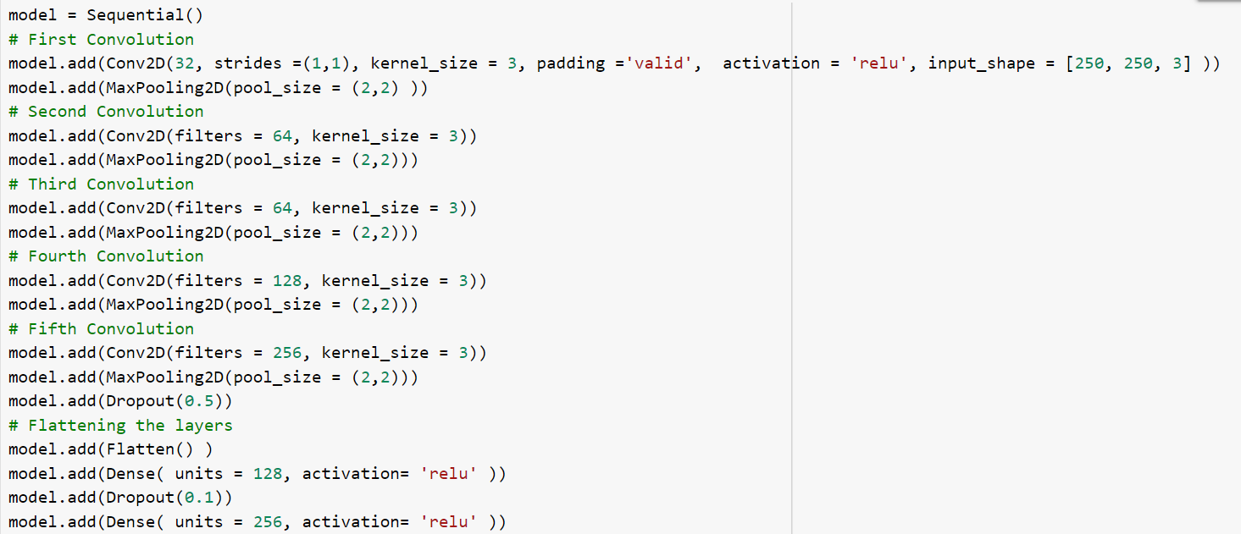
Model Building Phase
CNN Model
5 Convolutional Layer
4 Fully connected layer

Slide 16
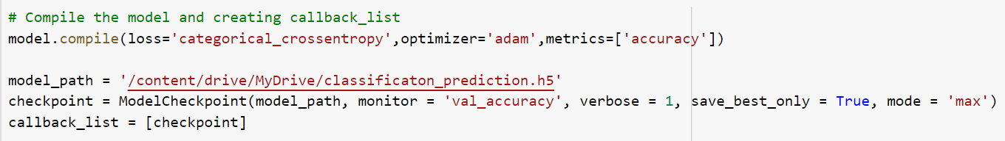
Model Building Phase
Compiling the model and Creating callback_list
Compiling the model and saving it at the maximum validation accuracy point

Slide 17
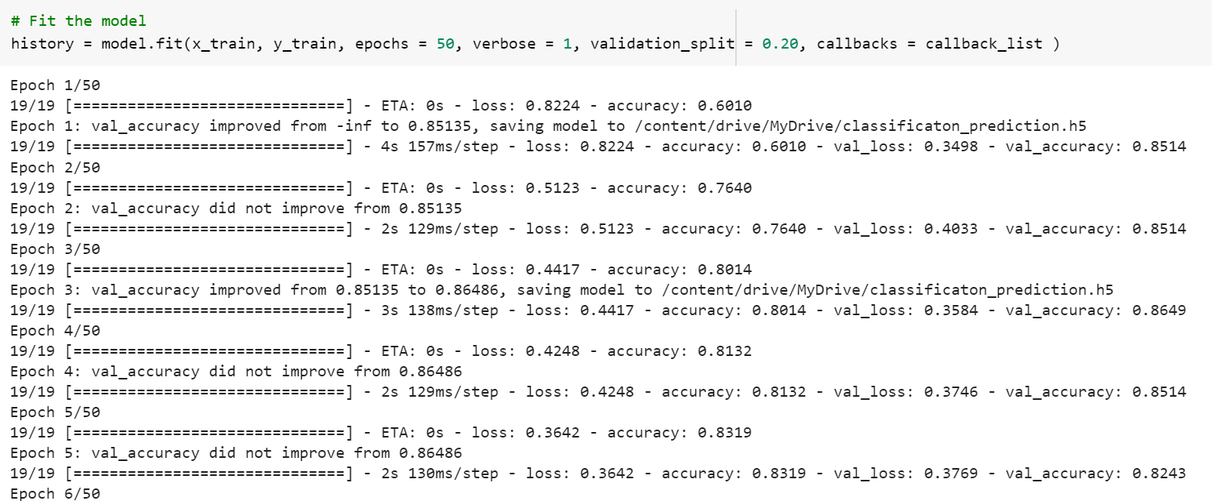
Model Building Phase
Training the model
50 epochs are used here, and 20 % data will be used for validation purpose

Slide 18
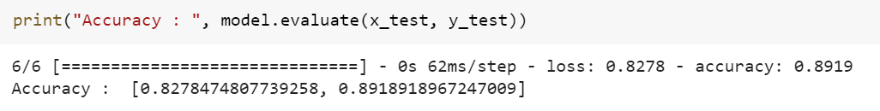
Model Building Phase
Evaluation of the model
Model accuracy is almost 90 %

Slide 19
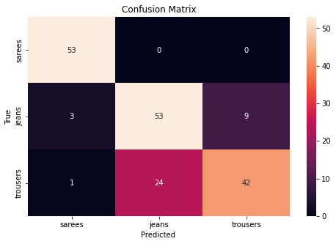
Model Building Phase
Confusion Matrix
By this confusion matrix, we can observe that, model is well working of sarees images, but it is bit confused in case of Jeans and Trousers

Slide 20

Model Building Phase
Saving ML Model
Saving the model in the Google drive with maximum validation accuracy

Slide 21
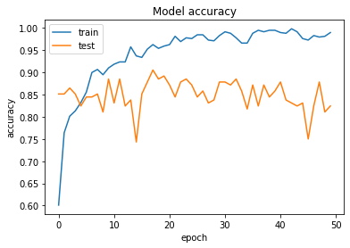
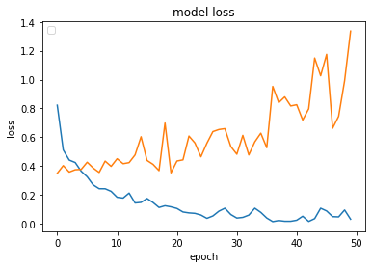

Performance Graph
Graph for model performance
As our model is not giving 100% accuracy, accordingly it is having some difference in data loss of training and test.

Slide 22
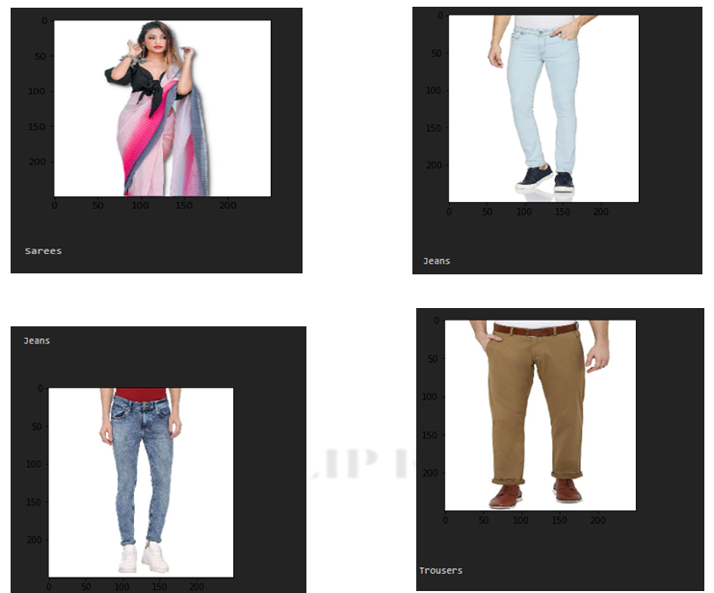
Model Building Phase
Conclusion/ Output of the Model
As per observation, this model is working fine for the saree but in case of jeans and trouser it is bit confused

Slide 23
Thanks you

